Slide 3


Get your SQL Questions answered here by our SQL Experts
(Across from Registration)

Slide 4

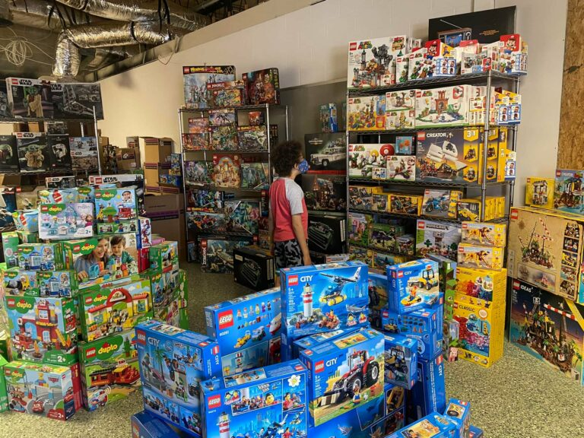
501 Legion Charitable Donation & LEGO Drive
Thank the 501 Legion for Supporting Our Event!
JSSUG Will Match Donations up to $1000
Donation Bucket on Registration Table
LEGO donation on V for Victory Table

Slide 5
Costume Contest Rules
1. Take a picture with the SQL Saturday Backdrop during the event
2. Post the picture to Twitter/X and include the hashtag #SQLSatJax24CC
3. The tweet using the hashtag that has the most "likes" wins a prize!

Slide 6
Session Evaluations
Your feedback is important to us!
Please fill out and hand to speaker after the session!

Slide 7
Event Evaluation
Fill out event evaluation card in your bag and visit all sponsors to be entered to win an Xbox Series X – (Must be present to win)

Slide 8


Slide 10
Introduction to SQL Level up with advanced features
Jeff Taylor
Principal Data Consultant
Database Consulting, LLC

Slide 11

Jeff
Taylor
A Senior Data Engineer, Architect & Consultant. Friend Of Redgate. Octopus Insider. Over 25 years of experience specializing in performance tuning and critical data issues.
Currently serving as the President of the Jacksonville SQL Server Users Group and is an active board member of the Jacksonville Development Users Group.
Principal Data Consultant
Database Consulting, LLC
Jeff@JeffTaylor.io
@ReviewMyDB
https://jefftaylor.io/blog

Slide 12
Agenda
Learning SQL
Constraints
Subqueries
Formatting
Dates

Slide 13
Examples of Constraints
Not Null
Unique
Default
Check
price > 0 AND price < 10,000

Slide 14
Learning advanced SQL requires a broader context.

Slide 15
Constraints

Slide 16
A constraint is a promise, enforced by the database engine.

Slide 17
Keys are Constraints
Primary Key
A unique, non-null combination of columns
Adds an index (could be non-clustered)
Foreign Key
Link to a different table
Guarantees existence
Cascading deletes and updates

Slide 18
Insert Error
The INSERT statement conflicted with the FOREIGN KEY constraint "RefPetOwner4". The conflict occurred in database "LearnSQL", table "dbo.PetOwner", column 'OwnerIdentifier'.

Slide 19
Subqueries

Slide 20
A subquery is a SELECT query, nested inside of another query

Slide 21
Where can they be used?
SELECT Statements
Data modification queries (DML)
Insert
Update
Delete

Slide 22
Types of Output
Single value
List of values
Table

Slide 23
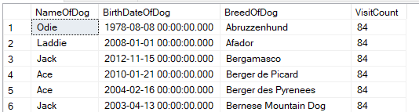
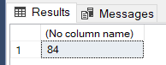
Single Value
SELECT [NameOfDog]
,[BirthDateOfDog]
,[BreedOfDog]
,(SELECT COUNT(*) FROM VeterinarianVisitHistory) AS VisitCount
FROM [Dog]

Slide 24
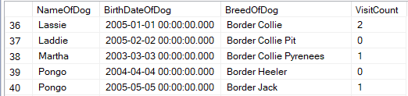
Correlated Subquery
SELECT [NameOfDog]
,[BirthDateOfDog]
,[BreedOfDog]
,(SELECT COUNT(*)
FROM VeterinarianVisitHistory AS VVH
WHERE VVH.DogIdentifier = D.DogIdentifier) AS VisitCount
FROM [Dog] D

Slide 25
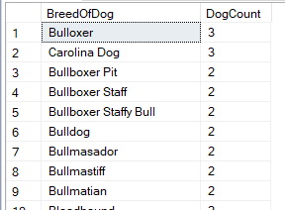
List of Values
SELECT BreedOfDog, COUNT(*) AS DogCount
FROM Dog
GROUP BY BreedOfDog
ORDER BY COUNT(*) DESC

Slide 26
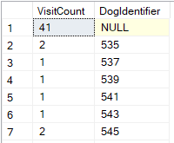
Tables
SELECT COUNT(*) AS VisitCount, DogIdentifier
FROM VeterinarianVisitHistory
GROUP BY DogIdentifier

Slide 27
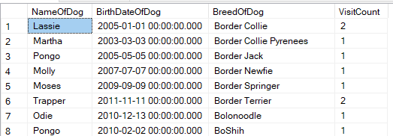
Tables
SELECT D.[NameOfDog]
,D.[BirthDateOfDog]
,D.[BreedOfDog]
,VVH.VisitCount
FROM [Dog] D INNER JOIN
(SELECT COUNT(*) AS VisitCount, DogIdentifier
FROM VeterinarianVisitHistory
GROUP BY DogIdentifier) AS VVH
ON D.DogIdentifier = VVH.DogIdentifier

Slide 28
Summary
A subquery is a nested SELECT statement
It can return a single value, a list, or a table
Keep an eye on performance
“In Transact-SQL, there is usually no performance difference between a statement that includes a subquery and a semantically equivalent version that does not.”

Slide 29
Formatting

Slide 30
Manual String (of Text) Manipulation
TRIM(' hello ') -> 'hello'
REVERSE(' hello ') -> ' olleh '
SUBSTRING(' hello ',6,4) -> 'ello'

Slide 31
Working with Dates

Slide 32
Working with Dates
Storing
Comparing/modifying
Extracting
Formatting

Slide 33
Jeff Taylor
Jeff@ReviewMyDB.com
@ReviewMyDB
https://www.linkedin.com/in/reviewmydb

